Slide 1
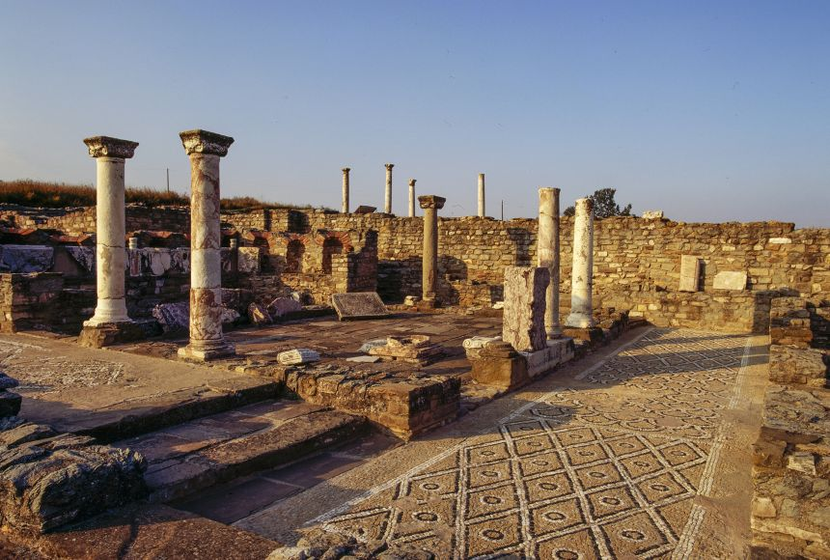
Ancient Macedonian Society
Goal/s:
Describe the features of ancient macedonia
Week 1 Lesson 2 – unit 2
Ms Barrie

Slide 2

REVIEW - Ancient Macedonia
Macedonia - small kingdom in northern Greece
established a growing empire from 359 BCE to 323 BCE
reign of several kings - monarchy began in 808 BCE with Caranus (first known king of Macedonia)
359 BCE - King Phillip II became ruler and united the southern Greek city-states with the north
brought them all under Macedonian rule
improved his army
devised plans to conquer other lands in the Mediterranean
died before he was able to put his plans into action
His son Alexander, later known as Alexander the Great, was able to expand Macedonia and usher in the Hellenistic age in the region.

Slide 3
ACTIVITY – Mindmap (Key Structures)
Create an A3 mindmap about the key structures of Ancient Macedonia
GLUE THIS IN YOUR BOOK AT THE END OF THE LESSON
Centre Title: ‘Ancient Macedonia’
Subheadings/Branches:
Social
Political
Economic
Religious
Military
Cultural
Each group will receive TWO information sheets with a type of structure.
You will have 8 minutes to read through it, and summarise it on your mindmap.
WE WILL BE DISCUSSING THESE AT THE END OF THE LESSON

